Slide 1

Data Modeling
Man is a knot, a web, a mesh into which relationships are tied. Only those relationships matter
Saint-Exupéry

Slide 2
Data modeling
A technique for modeling data
A graphical representation of a database
The goal is to identify the facts to be stored in the database
Data modeling is a partnership between the client and analyst

Slide 3
Modeling
 |  | Scope | Model | Technology
Motivation | why | Goals | Business plan | Groupware
People | who | Business units | Organization chart | Systems interface
Time | when | Key events | PERT chart | Scheduling
Data | what | Key entities | Data model | Relational database
Function | how | Key processes | Process model | Application software
Network | where | Locations | Logistics network | System architecture

Slide 4
The building blocks
Entity
Attribute
Relationship
Identifier

Slide 5
Data model quality
A well-formed data model
A high fidelity image

Slide 6
A well-formed data model
Construction rules obeyed
No ambiguity
  All entities, attributes, relationships, and identifiers are defined
  Names are meaningful to the client

Slide 7
A high fidelity image
Faithfully describes the world it is supposed to represent
Relationships are of the correct degree
Data model is complete, understandable, and accurate
The data model makes sense to the client

Slide 8
Quality improvement
Is the level of detail correct?
Are all exceptions handled?
Is the model accurate?

Slide 9
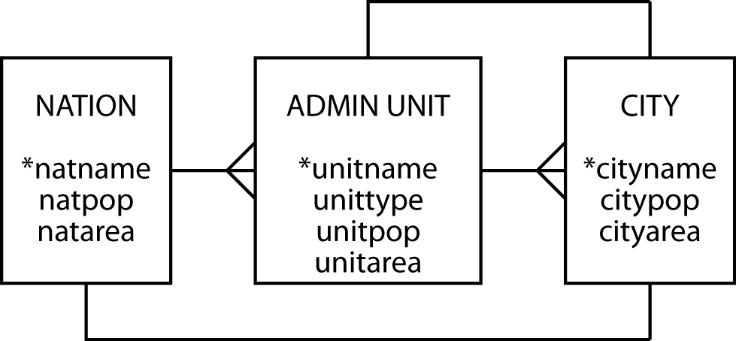
Pure geography

Slide 10
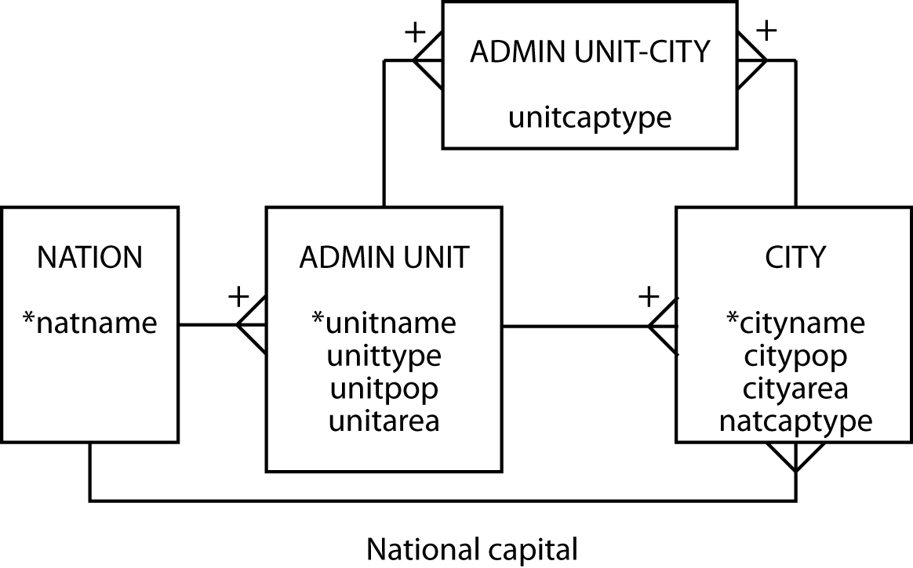
Geography revised

Slide 11
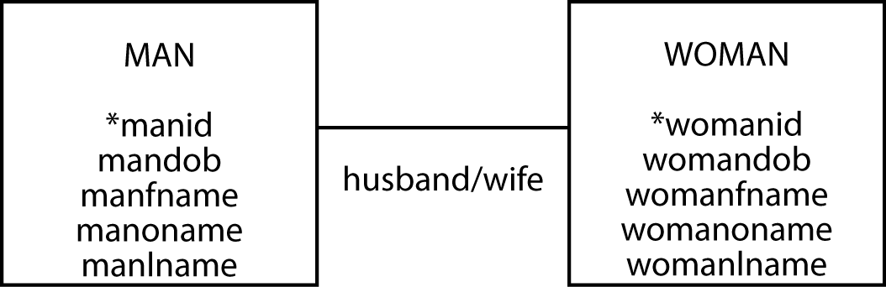
Family matters - take 1

Slide 12
Family matters - take 2

Slide 13
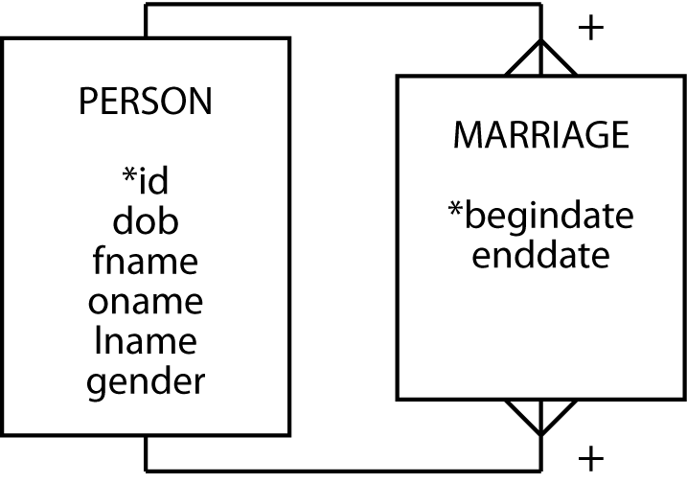
Family matters - take 3

Slide 14
Family matters - take 4

Slide 15
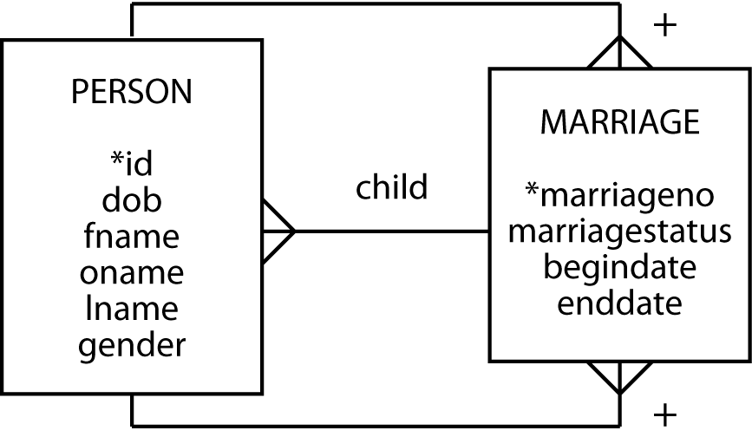
Family matters - take 5

Slide 16
Bookish matters - take 1

Slide 17

Bookish matters - take 2

Slide 18
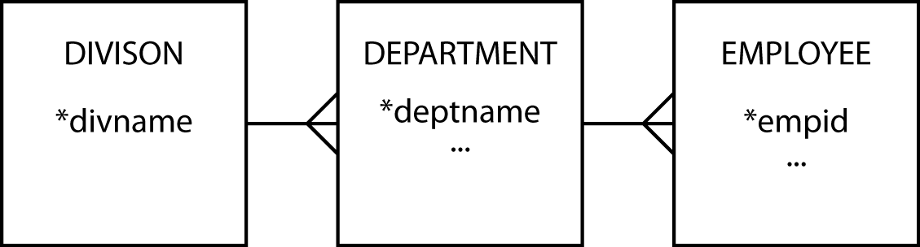
History - take 1

Slide 19
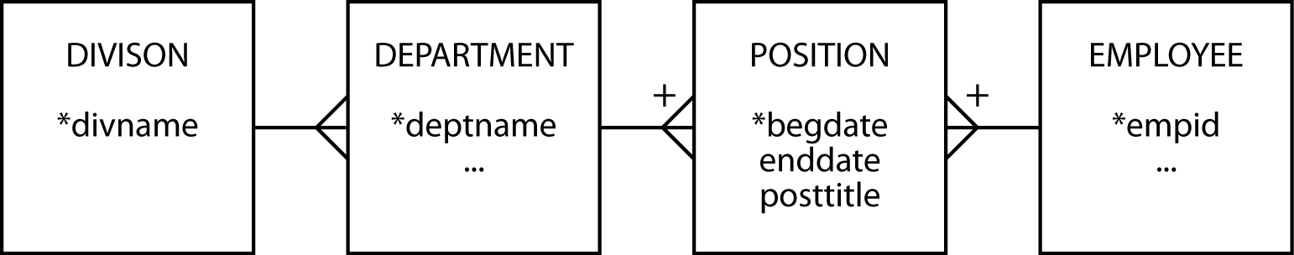
History - take 2

Slide 20
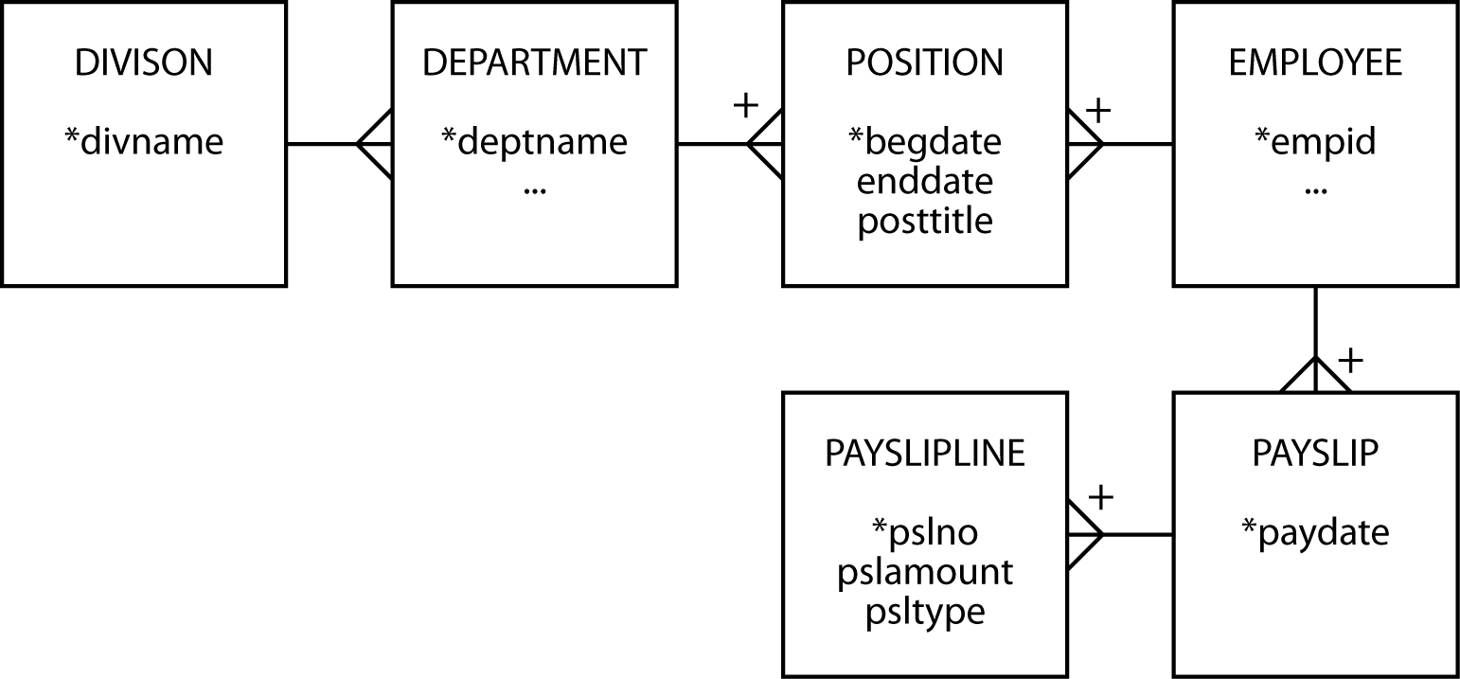
History - take 3

Slide 21
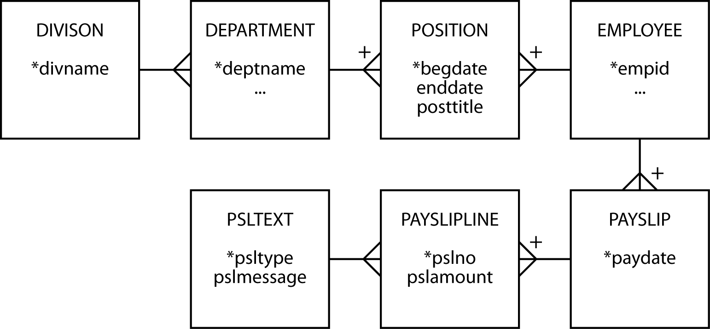
History - take 4

Slide 22
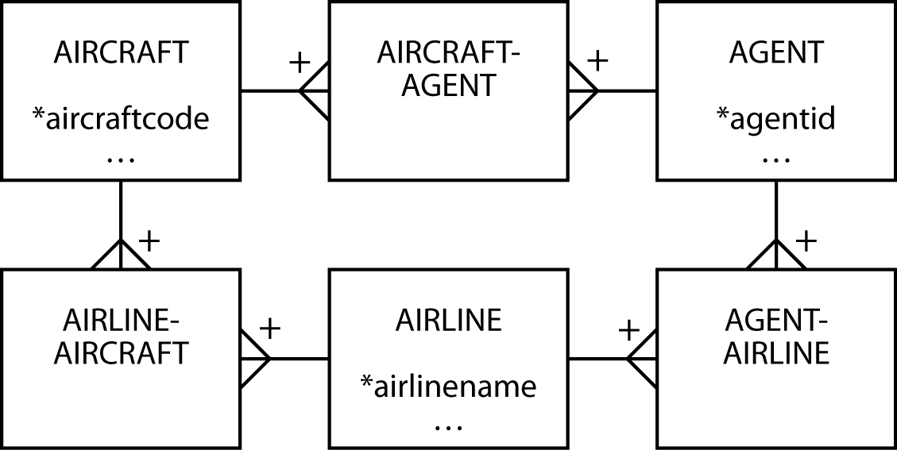
A ménage à trois for entities - take 1

Slide 23
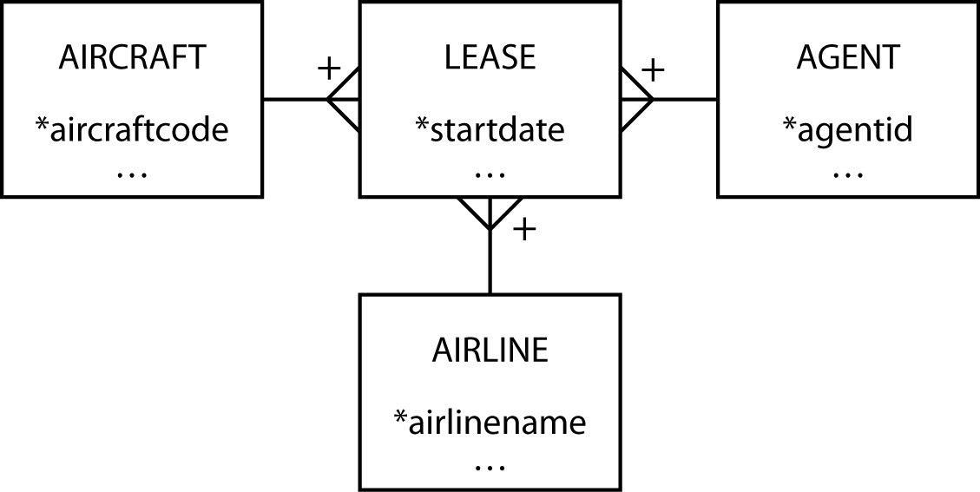
A ménage à trois for entities - take 2

Slide 24
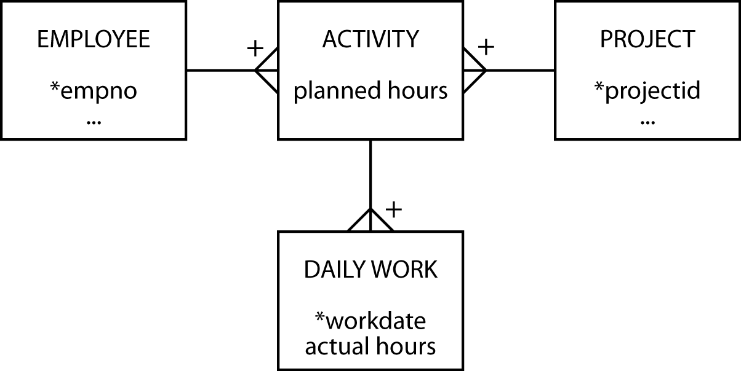
Planning and doing - take 1

Slide 25
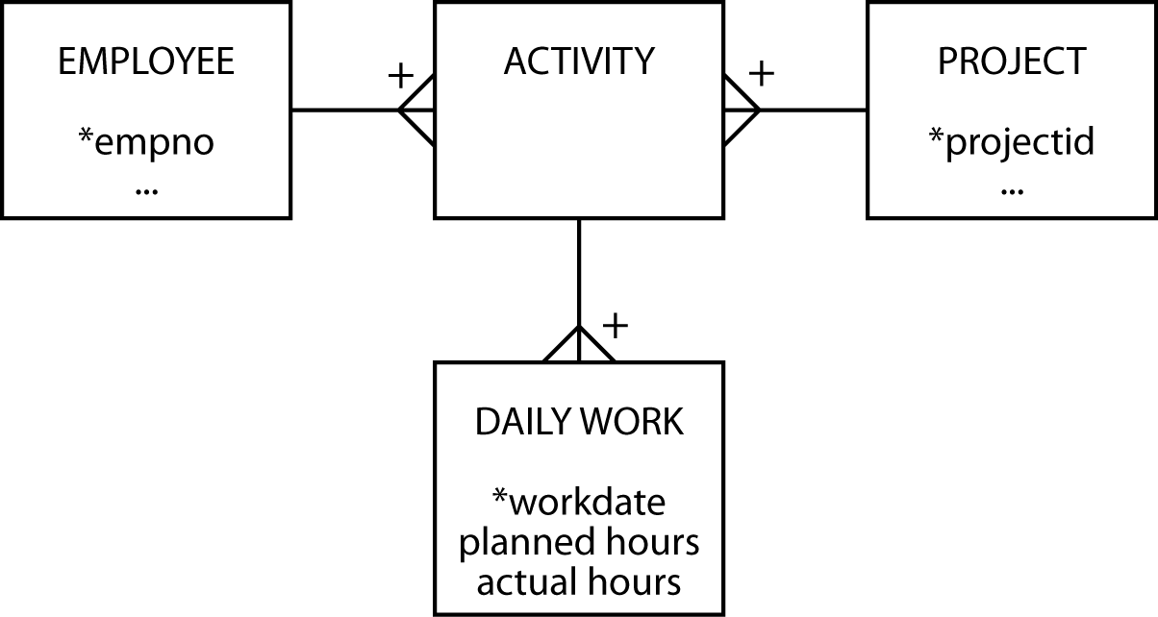
Planning and doing - take 2

Slide 26
Entity types
Independent
Dependent
Associative
Aggregate
Subordinate

Slide 27
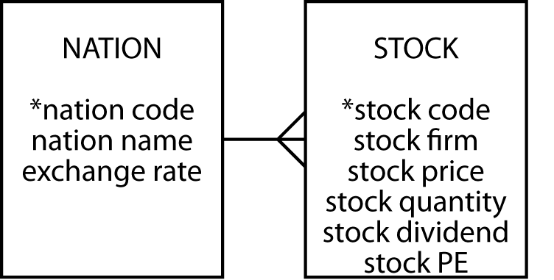
Independent
Often a starting point
Prominent in the client's mind
Often related to other independent entities

Slide 28
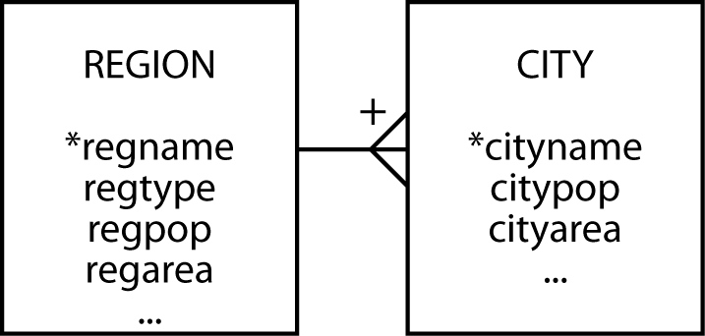
Dependent
Relies on another entity for its existence and identification
Can become independent if given an arbitrary identifier

Slide 29
Associative
A by-product of an m:m relationship
Typically between independent entities
Can store current or historical data
Can become independent if given an arbitrary identifier

Slide 30
Aggregate
Created from several different entities that have a common prefix or suffix
Commonly used with addresses or names

Slide 31
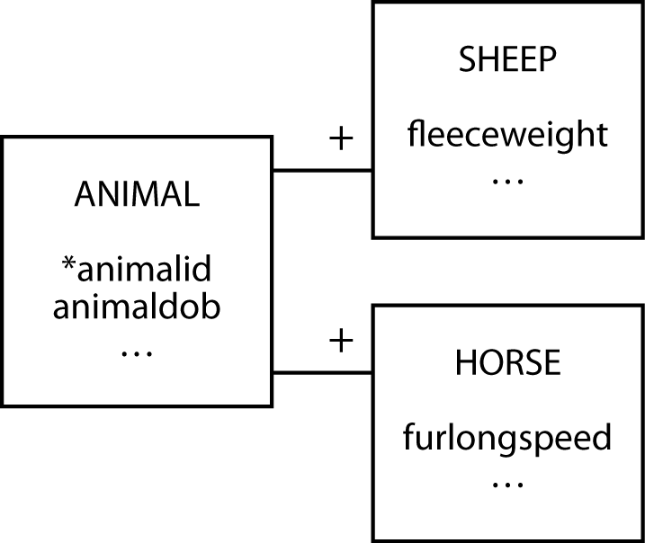
Subordinate
An entity with data that can vary among instances

Slide 32
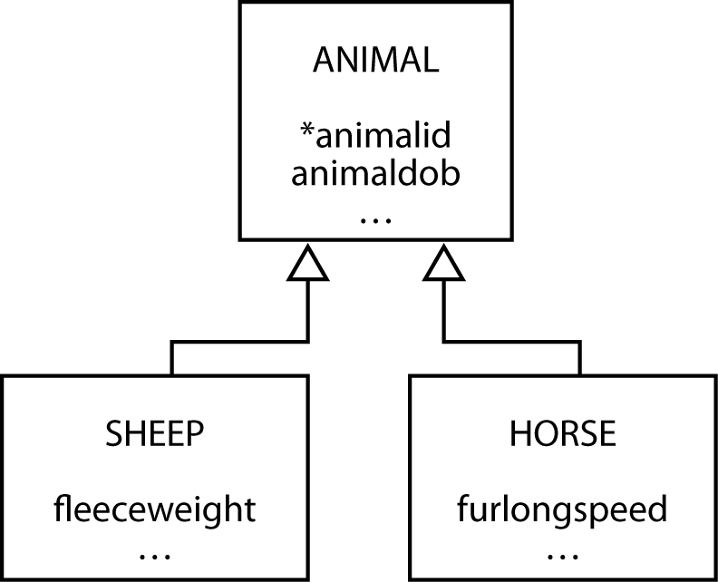
Generalization
A relationship between a more general element and a more specific element

Slide 33
Generalization
Map with one table for each entity
For each of the subtype entities the primary key is that of the supertype entity
You must also make this column a foreign key so that a subtype cannot be inserted without the presence of the matching supertype

Slide 34
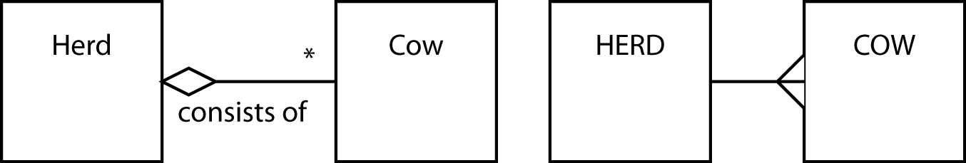
Aggregation
Aggregation is a part-whole relationship between two entities

Slide 35

Shared aggregation
One entity owns another entity, but other entities can own that entity as well

Slide 36
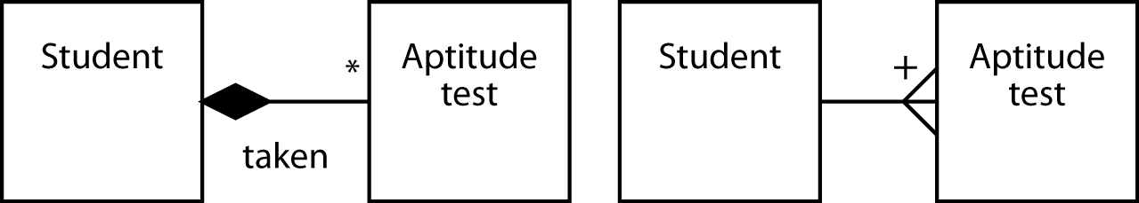
Composite aggregation
One entity exclusively owns the other entity

Slide 37
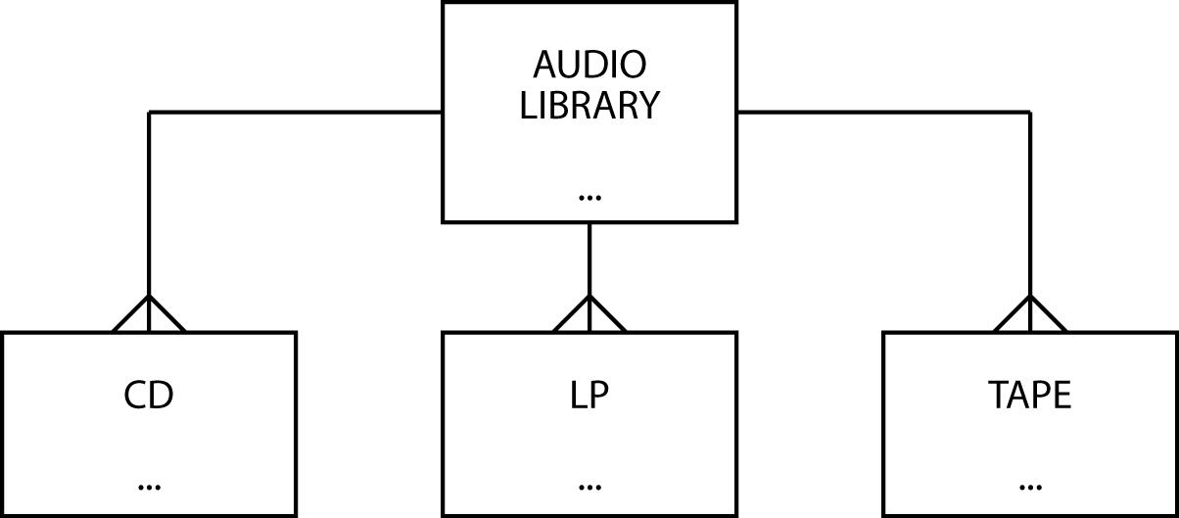

Data model contraction

Slide 38
Hints on data modeling
The model will expand and contract
Invent identifiers where necessary
Identifiers should have only one purpose – identification
A data model does not imply ordering
Create an attribute if ordering of instances is required
An attribute’s meaning must be consistent

Slide 39
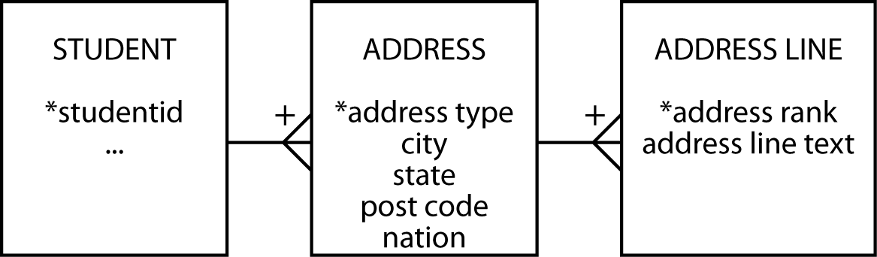
Names and addresses
The query test
  If an attribute has parts, are any of the parts ever likely to appear in a query?
Have an understanding on representing names and addresses in a data model

Slide 40
Hints on data modeling
Single instance entities are OK
Select names carefully
Synonyms—different words have the same meaning
  Get clients to settle on a common word or use views
Homonyms—same word has different meanings
  Clarify to avoid confusion
Naming associative entities
  Concatenate entity names if there is no obvious real world name

Slide 41
Hints on data modeling
Uncover all exceptions
Label relationships to avoid ambiguity
Keep the data model well-formed and accurate

Slide 42
Meaningful identifiers
An identifier is meaningful when some attributes of the entity can be inferred from the identifier’s value
Advantages | Disadvantages
Recognizable and rememberable | Identifier exhaustion
Administrative simplicity | Reality changes
 | Loss of meaningfulness

Slide 43
Recommendation
Nothing, however, is lost and much is gained by using non-meaningful identifiers
Non-meaningful identifiers serve their sole purpose well
  To uniquely identify an entity
Attributes are used to describe the characteristics of the entity
A clear distinction between the role of identifiers and attributes creates fewer data management problems

Slide 44
The seven habits of highly effective data modelers
Immerse
Challenge
Generalize
Test
Limit
Integrate
Complete

Slide 45
Key points
A high-fidelity data model handles all exceptions
Identifiers need only identify an instance
Data modeling skills take time to develop

